Slide 1
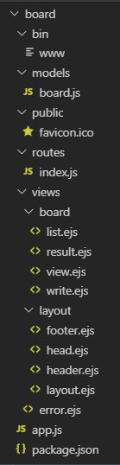
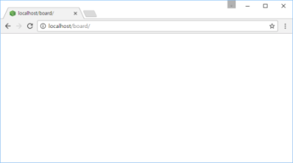

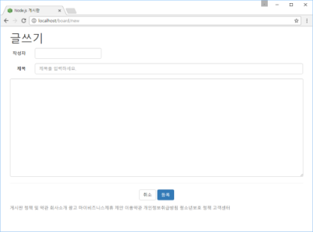
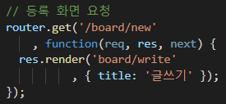
http://localhost/board/new 요청
Controller
Web browser
www
app.js
2
logger
bodyParser
1
cookieParser
static 자원처리
session
......
3
routes
error handling
6
View
4
index.js
header.ejs
include
body
footer.ejs
include
write.ejs
5
view engine(ejs)

Slide 2

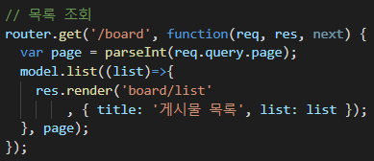
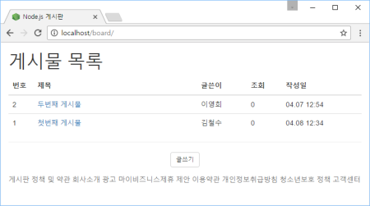
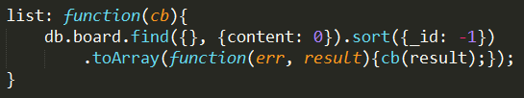
http://localhost/board 요청
Controller
Web browser
www
app.js
2
...
1
3
routes
View
6
4
7
Model
board.js
header.ejs
body
footer.ejs
list.ejs
5
view engine(ejs)
DB

Slide 3
Controller
www
app.js
Model
bodyParser
cookieParser
routes
session
...
board.js
routes
board.js
error handling
View
MongoDB
layout.ejs
Oracle
MySQL
list.ejs

